Slide 1
DATA ANALYTICS
PROJECT
PIZZA
SALES
Turning raw orders into tasty insights with Microsoft SQL Server
Revenue
Orders
Best Sellers
Peak Hours
Presented by Aman Gusain | Aspiring Data Analyst
Notes:
Cover slide. Tip: add Fade/Zoom entrance animations to the title and pizza shapes, and group the pizza shapes to spin it with a Spin emphasis animation.

Slide 2
PROJECT INTRODUCTION
In the competitive food and beverage industry, data-driven decision-making is essential for improving profitability, optimizing inventory, and understanding customer preferences. This project analyses the sales data of a pizza restaurant using Microsoft SQL Server (SSMS) to uncover meaningful business insights.
The dataset is organized as a relational database comprising four interlinked tables:
By joining these tables and applying SQL techniques such as aggregations, joins, subqueries, Common Table Expressions (CTEs), and window functions, this project transforms raw transactional data into actionable insights on revenue, demand patterns, and product performance.
1
Orders
2
Pizza
3
Orders details
4
Pizza types
Order_Id
Date
Time
Pizza ID
Size
Price
Pizza type ID
Order Details ID
Order ID
Pizza ID
Quanitity
Pizza type ID
Name
Category
Ingredients
INTERACTIVE PROMPT → Click through each stop to see the SQL story
Presented by Aman Gusain | Aspiring Data Analyst

Slide 3
PROJECT OBJECTIVES
What this SQL project is built to answer
From performance measurement to menu optimization — each objective turns raw orders into a practical business decision.
01 PERFORMANCE
02 CUSTOMER + TIME
03 GROWTH + ACTION
1. Measure overall business performance: total orders, total revenue, and total pizzas sold.
2. Identify best-selling products: most ordered pizza types and highest-quantity items.
3. Analyze revenue contribution across pizzas, sizes, and categories.
4. Evaluate customer preferences through popular sizes and category-wise order distribution.
5. Determine peak business hours and days using hourly, daily, and monthly order trends.
6. Calculate average order value and average pizzas per order to understand spending behavior.
7. Track cumulative revenue over time with window functions.
8. Find top and bottom pizzas within each category for menu optimization.
9. Analyze ingredient popularity for inventory planning and new menu development.
10. Deliver data-backed recommendations for sales, staffing, promotions, and inventory.
TOOLS + TECHNOLOGIES
Database • Microsoft SQL Server (SSMS)
Language • SQL
Joins • Aggregates • CTEs • Subqueries • Window Functions • Date/Time Functions
Objective map | Click through each lane to connect the SQL technique to the business question

Slide 4
CASE STUDY QUESTIONS
What should the SQL analysis answer?
A guided question set moving from order-level retrieval to revenue, timing, and trend analysis.
01 ORDER EXPLORATION
02 REVENUE + CUSTOMER
03 TRENDS + DIAGNOSTICS
1. Retrieve all orders placed on 2015-01-01.
2. List all distinct pizza categories.
3. Find the total number of pizzas ordered.
4. Get the top 5 most frequently ordered pizza types.
5. Show order_id and total pizzas ordered in each order.
6. Find the number of orders placed in each hour of the day.
7. Find the day of the week with the maximum number of orders.
8. Find the earliest and latest order time for each day.
9. Find total revenue from each pizza type and identify the top revenue category.
10. Find the average number of pizzas ordered per order.
11. List the top 3 orders by spend.
12. Calculate cumulative revenue throughout the day.
13. Identify the least-ordered pizza.
14. Find each category's percentage contribution to total revenue.
15. Find the maximum order-time difference for each day.
16. Calculate the rolling sales average for the last 3 months.
17. Compare current vs. previous month sales and show only declines.
SQL TOOLKIT • SELECT • GROUP BY • DATEPART • CTEs • WINDOW FUNCTIONS • LAG • ROLLING AVERAGES
Case study map | Follow the questions from raw orders to management insight

Slide 5
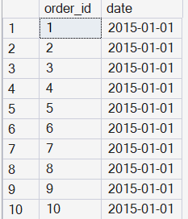
Pizza Sales Report
1. Retrieve all orders placed on 2015-01-01.
Query –
select order_id, date from orders where date = '2015-01-01'
Result -

Slide 6
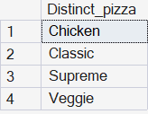
Pizza Sales Report
2. List all distinct pizza categories available.
Query –
select distinct(category) Distinct_pizza from pizza_types
Result -

Slide 7

Pizza Sales Report
3. Find total number of pizzas ordered.
Query –
select sum(quantity) Total_Pizzas from orders_details
Result -

Slide 8
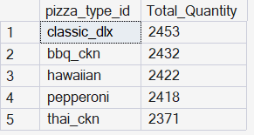
Pizza Sales Report
4. Get the top 5 most frequently ordered pizza types.
Query –
select top 5 pt.pizza_type_id, sum(od.quantity) Total_Quantity
from pizza_types pt join pizzas p on pt.pizza_type_id = p.pizza_type_id
join orders_details od on od.pizza_id = p.pizza_id
group by pt.pizza_type_id order by Total_Quantity desc
Result -

Slide 9
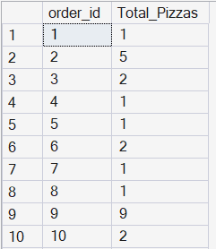
Pizza Sales Report
5. Show order_id and total pizzas ordered in each order.
Query –
select order_id, sum(quantity) Total_Pizzas from orders_details
group by order_id order by order_id
Result -

Slide 10
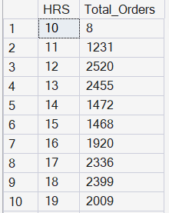
Pizza Sales Report
6. Find the number of orders placed in each hour of the day.
Query –
select DATENAME(HOUR, time) HRS, count(distinct order_id)
Total_Orders from orders
group by DATENAME(HOUR, time) order by HRS
Result -

Slide 11

Pizza Sales Report
7. Find the day of the week on which the maximum number of orders were placed.
Query –
select top 1 DATENAME(WEEKDAY, date) Dayname, count(order_id)
Total_Orders from orders
group by DATENAME(WEEKDAY, date) order by Total_Orders desc
Result -

Slide 12
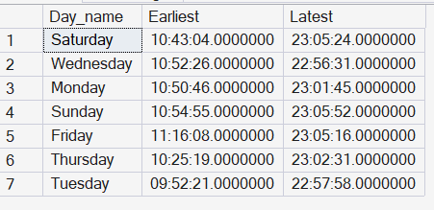
Pizza Sales Report
8. Find the earliest and latest order time for each day.
Query –
select DATENAME(WEEKDAY, date) Day_name, MIN(time) Earliest, MAX(time) Latest
from orders group by DATENAME(WEEKDAY, date)
Result -

Slide 13
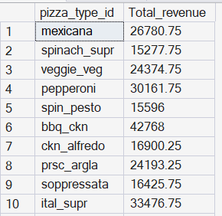
Pizza Sales Report
9.Find the total revenue generated from each pizza type.
Query –
select pt.pizza_type_id, round(sum(od.quantity*p.price),2) Total_revenue
from orders_details od join pizzas p on
od.pizza_id = p.pizza_id join pizza_types pt on
pt.pizza_type_id = p.pizza_type_id group by pt.pizza_type_id
Result -

Slide 14

Pizza Sales Report
10. Which pizza category generated the maximum revenue?
Query –
select top 1 pt.category, round(sum(od.quantity*p.price),2) Total_revenue
from orders_details od join pizzas p on
od.pizza_id = p.pizza_id join pizza_types pt on
pt.pizza_type_id = p.pizza_type_id group by pt.category
order by Total_revenue desc
Result -

Slide 15

Pizza Sales Report
11. Find the average number of pizzas ordered per order.
Query –
with cte as (
select order_id, sum(quantity) Total_Orders from orders_details
group by order_id)
select AVG(cte.Total_Orders) Avg_Pizza_ordered from cte
Result -

Slide 16
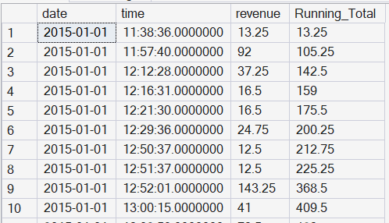
Pizza Sales Report
13. Find the cumulative revenue generated throughout the day (running total).
Query –
select o.date,o.time,
round(sum(od.quantity * p.price),2) revenue,
sum((sum(od.quantity * p.price))) over (partition by o.date order by o.time)
Running_Total
from orders o join orders_details od on o.order_id = od.order_id
join pizzas p on od.pizza_id = p.pizza_id group by o.date, o.time
Result -

Slide 17

Pizza Sales Report
14. Identify the pizza that has been ordered the least number of times.
Query –
select top 1 pt.name,
count(od.order_details_id) Times_ordered
from orders_details od
join pizzas p on od.pizza_id = p.pizza_id
join pizza_types pt on p.pizza_type_id = pt.pizza_type_id
group by pt.name order by times_ordered
Result -

Slide 18
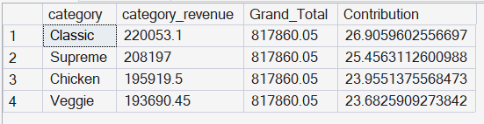
Pizza Sales Report
15. Find the percentage contribution of each pizza category to total revenue.
Query –
select pt.category, round(sum(od.quantity * p.price),2) category_revenue,
sum(round(sum(od.quantity * p.price),2)) over() Grand_Total,
(round(sum(od.quantity * p.price),2) * 100.0) /
sum(round(sum(od.quantity * p.price),2)) over() as Contribution
from orders_details od join pizzas p on od.pizza_id = p.pizza_id
join pizza_types pt on p.pizza_type_id = pt.pizza_type_id
group by pt.category order by Contribution desc
Result -

Slide 19
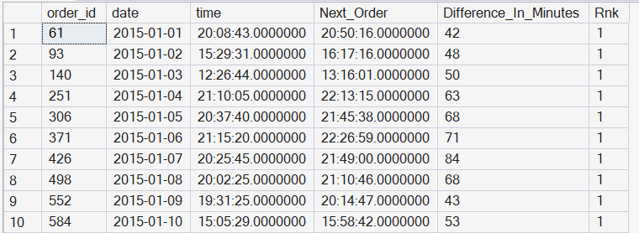
Pizza Sales Report
16. Find the maximum difference (in minutes) of each orders placed on each day.
Query –
with cte as (
select *, lead(time) Over(partition by date order by time) as Next_Order,
DATEDIFF(MINUTE, time, lead(time) over (partition by date order by time))
Difference_In_Minutes from orders ), cte2 as (
select *, DENSE_RANK() over(partition by cte.date order by cte.Difference_In_Minutes desc) Rnk from cte )
select * from cte2 where cte2.Rnk = 1
Result -

Slide 20
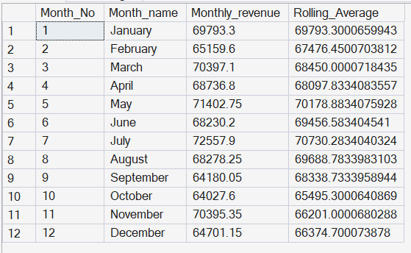
Pizza Sales Report
17. Find the rolling sales average of last 3 months.
Query –
select DATEPART(MONTH, o.date) Month_No, DATENAME(MONTH, o.date) Month_name, round(sum(od.quantity * p.price),2) Monthly_revenue,
AVG(sum(od.quantity * p.price)) Over(order by DATEPART(MONTH, o.date)
rows between 2 preceding and current row) as
Rolling_Average from orders o join orders_details od on o.order_id = od.order_id
join pizzas p on od.pizza_id = p.pizza_id
group by DATEPART(MONTH, o.date), DATENAME(MONTH, o.date)
Result -

Slide 21
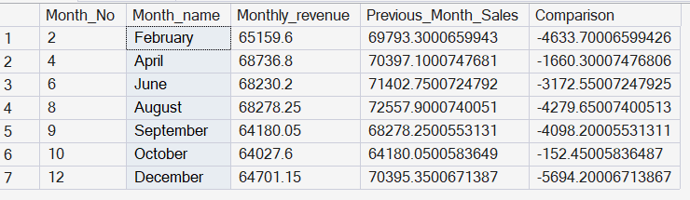
Pizza Sales Report
18. Compare the previous month sales with the current month and show only
declining sales.
Query –
With cte as ( select DATEPART(MONTH, o.date) Month_No, DATENAME(MONTH, o.date) Month_name,
round(sum(od.quantity * p.price),2) Monthly_revenue,
LAG(sum(od.quantity * p.price),1,0) Over (order by DATEPART(MONTH, o.date))
Previous_Month_Sales, round(sum(od.quantity * p.price),2) -
LAG(sum(od.quantity * p.price),1,0) Over (order by DATEPART(MONTH, o.date))
Comparison from orders o join orders_details od on o.order_id = od.order_id
join pizzas p on od.pizza_id = p.pizza_id
group by DATEPART(MONTH, o.date), DATENAME(MONTH, o.date))
select * from cte where cte.Comparison < 0
Result -

Slide 22
CONCLUSION
1
2
THE FINAL
Business Health
Top Performers
Total orders, revenue and pizzas sold gave a clear snapshot of overall performance.
Best-selling pizzas, sizes and categories reveal what drives revenue.
SLICE
3
4
Raw orders turned into tasty, actionable insights with Microsoft SQL Server.
Peak Demand
Smarter Menu
Hourly, daily and monthly trends show when to staff up and run promotions.
Top and bottom sellers plus popular ingredients guide menu and inventory.
Thank You!
Let’s connect: amangusain8920@gmail.com
Recommendation: Promote top sellers, staff for peak hours, and trim low performers.
Aman Gusain | Aspiring Data Analyst
Notes:
Conclusion slide. Tip: add Fade entrance animations to the four cards (After Previous) and make the Thank You button pop with Zoom. Replace card text with your actual findings (e.g., top pizza, peak hour).

